Slide 1


Data
Analytics

Slide 2


Today’s Agenda
Project Recap
Problem
The Analytics Team
Process
Insights
Summary

Slide 3

Over a 3-month period, we collaborated with Social Buzz, tackling crucial aspects like auditing their big data practices, providing IPO guidance, and analyzing content categories. Our efforts aimed to equip them for successful scaling and IPO preparation.
Project Recap

Slide 4

Problem
Social Buzz, a rapidly growing social media and content creation platform, faces significant challenges as it scales its operations. With over 500 million monthly active users and a highly complex data infrastructure, the company struggles to effectively manage and analyze the massive amount of unstructured data generated daily. Additionally, Social Buzz is gearing up for an IPO within the next year, necessitating guidance and support to ensure a smooth transition to becoming a publicly traded company. Moreover, as a relatively small organization, they lack the resources and expertise to address these challenges internally. Thus, they seek external assistance to optimize their big data practices, receive recommendations for a successful IPO, and understand best practices from industry leaders.

Slide 5

The Analytics team
Nasir Uddin Ahmed
Data Analyst

Slide 6
Process
1
Data Understanding
2
Data Cleaning
3
Data Modelling
4
Data Analysis
5
Revealing Insights

Slide 7

Insights
Category with Highest Score (Animal)
Total Unique Categories
Month with the Most Number of Posts
75 K
16
May

Slide 8
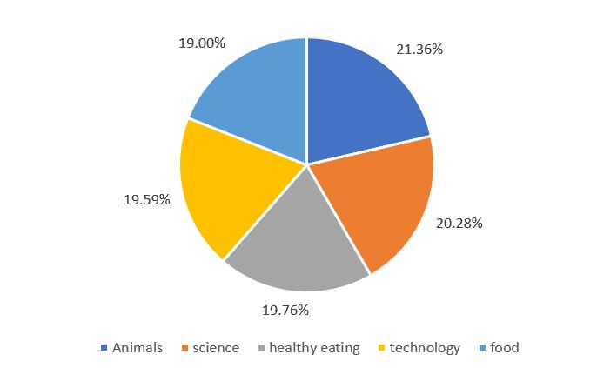
Percentage of Top 5 Categories

Slide 9
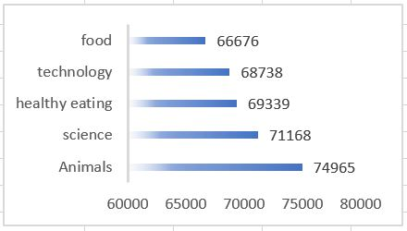
Top 5 Category Aggregated Popularity Score

Slide 10
Animals and Science are the top 2 most popular categories.
Summary
Sentiment has 3 data labels.
Public Speaking is less popular category.

Slide 11
Thank you!
ANY QUESTIONS?

